Slide 1
Rick and Kyle Build the Duckhunter

Slide 2
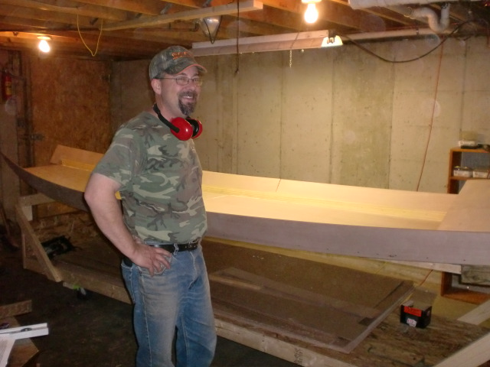
Notes:
Chief Financial Officer and Lead Donkey

Slide 3
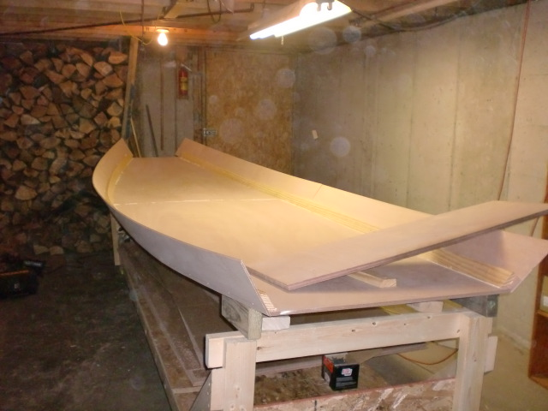
Notes:
Starting the DH build in my basement. We hope it fits through the door.

Slide 4
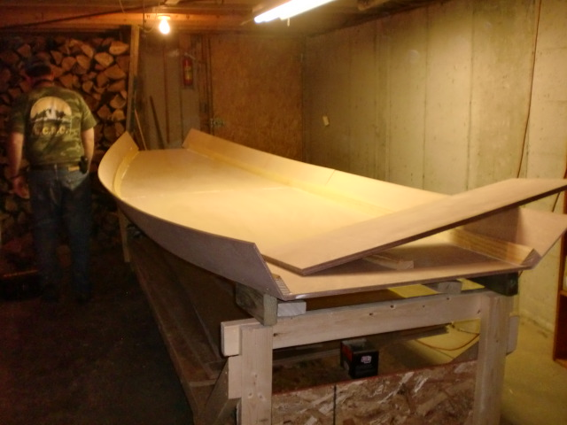
Notes:
Getting ready to cut some more expensive plywood.

Slide 5
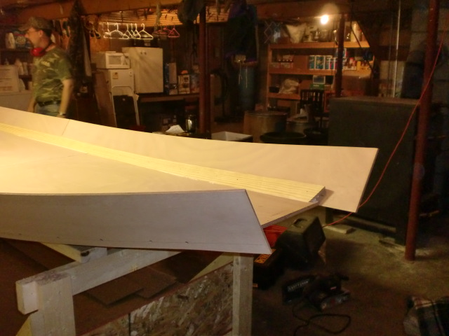
Notes:
Bending the sides into place

Slide 6
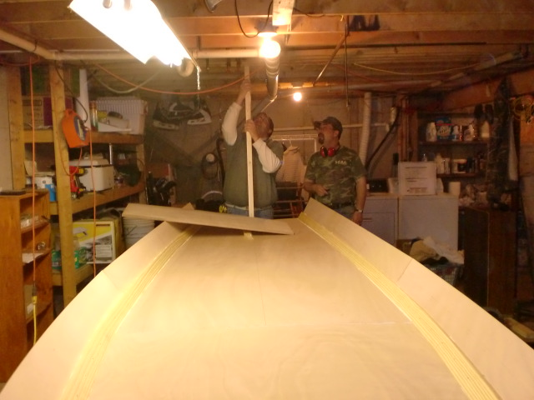
Notes:
First mishap….. When we pulled the sides in, the bottom bowed the wrong way….

Slide 7
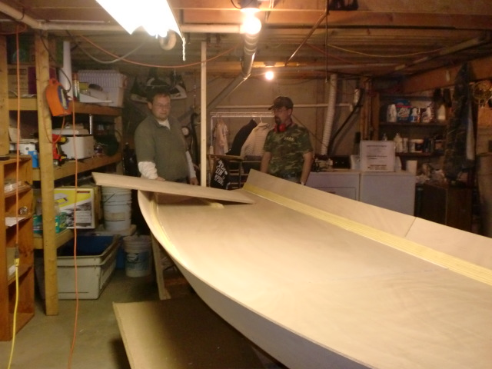
Notes:
Rigging up a three masted schooner to get the bottom back in shape

Slide 8
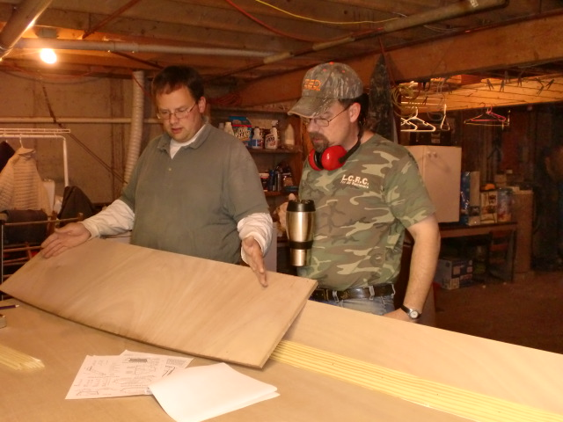
Notes:
Getting ready to lose my master craftsman since there are no square corners anywhere on this project

Slide 9
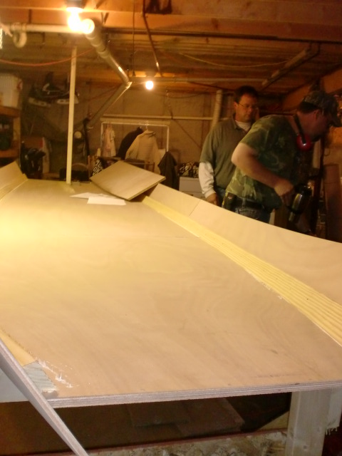
Notes:
Me and my coffee cup planning morning tasks…

Slide 10
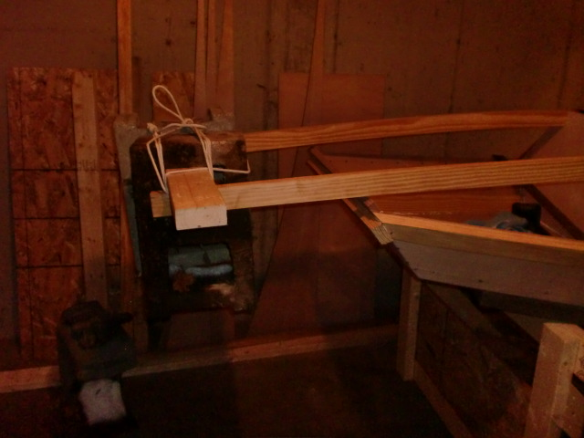
Notes:
Adding some weight to the top rails to get them to bend

Slide 11
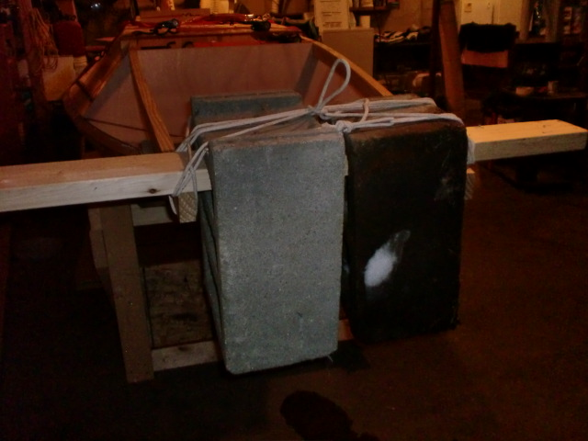
Notes:
Adding more weight…

Slide 12
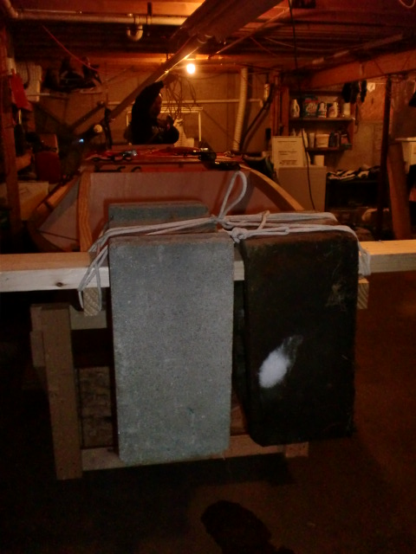
Notes:
Tied up weights so they don’t fall off onto Ellie….

Slide 13
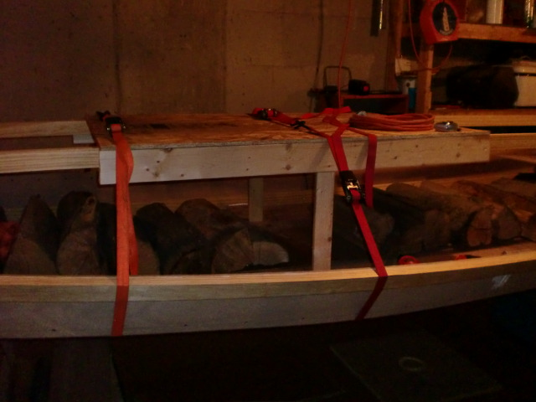
Notes:
We had to strap down the top of the rails because of all the pressure on the front…

Slide 14
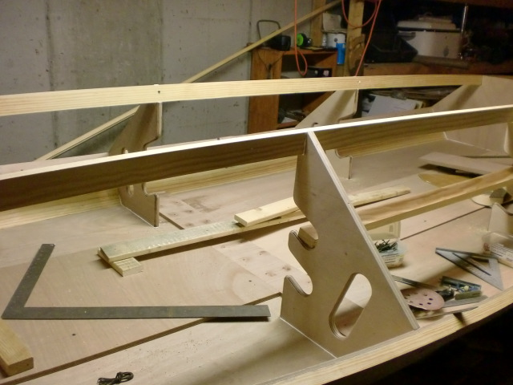
Notes:
Adding the rest of the framing

Slide 15
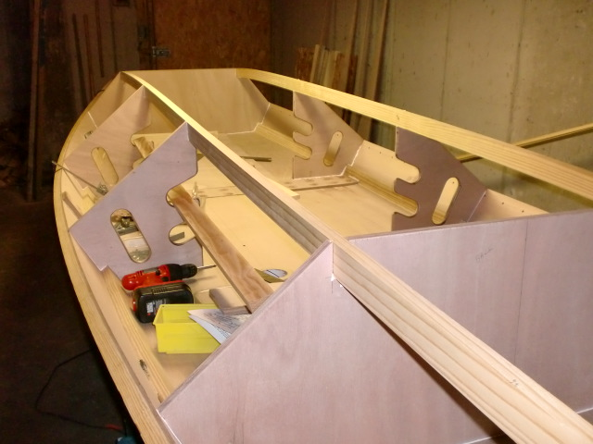

Slide 16
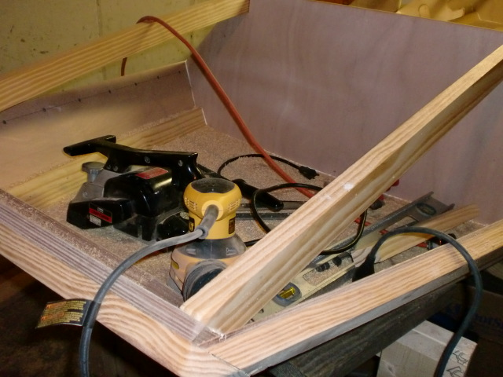
Notes:
More sanding

Slide 17
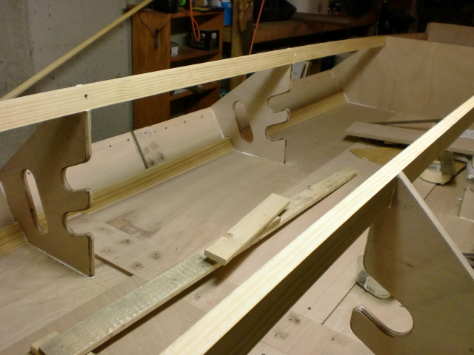
Notes:
More framing

Slide 18
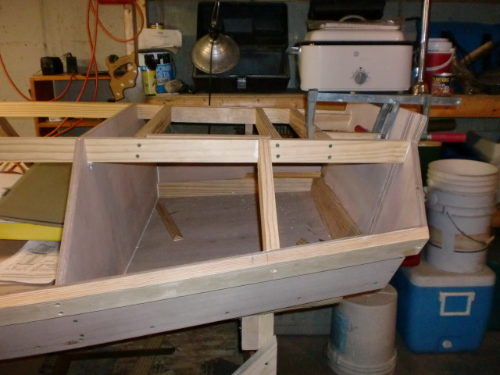
Notes:
Finishing up the framing

Slide 19
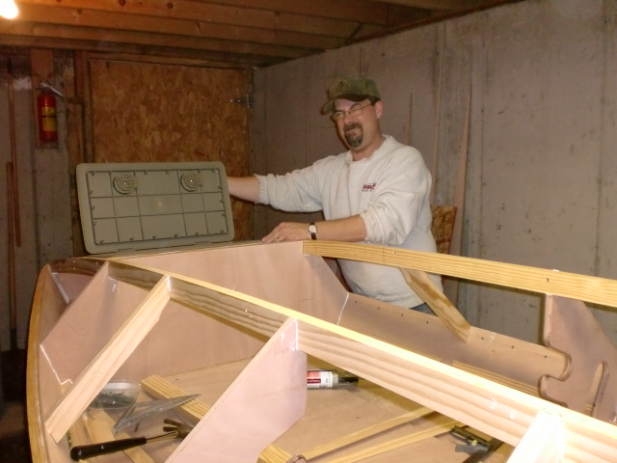
Notes:
Testing the hatches I bought myself for Christmas

Slide 20
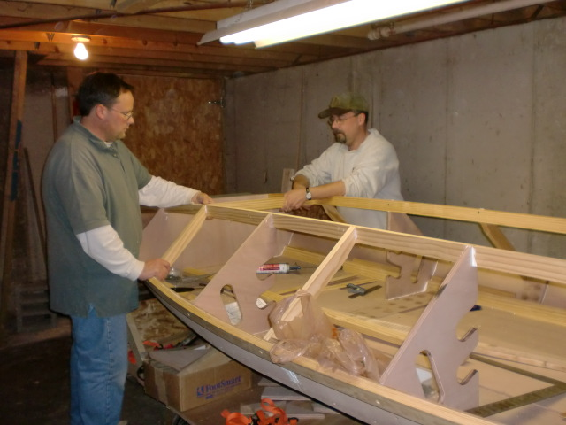
Notes:
Thanks God he’s in charge of this project. I would have burned it up long ago.

Slide 21
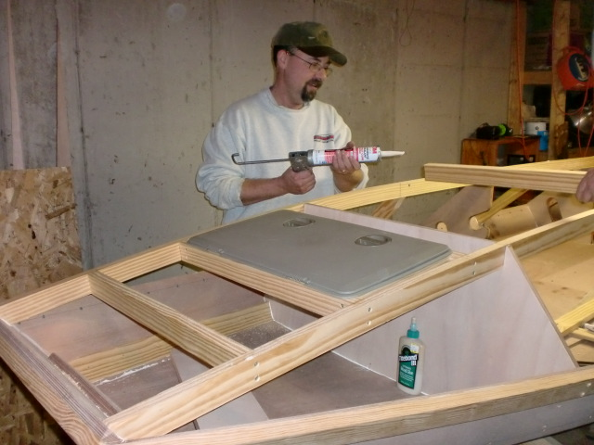
Notes:
Something I can do

Slide 22
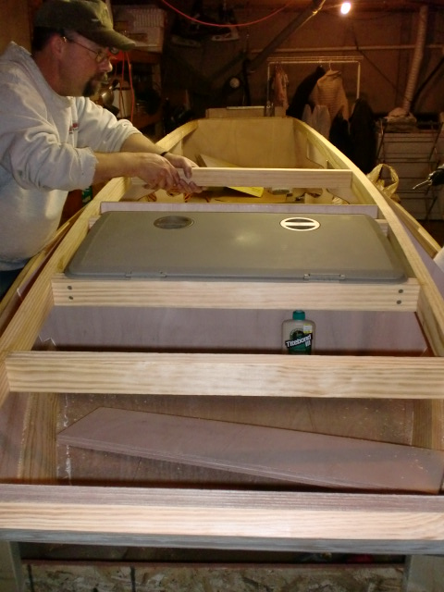
Notes:
“Ill hold it while you screw it”

Slide 23
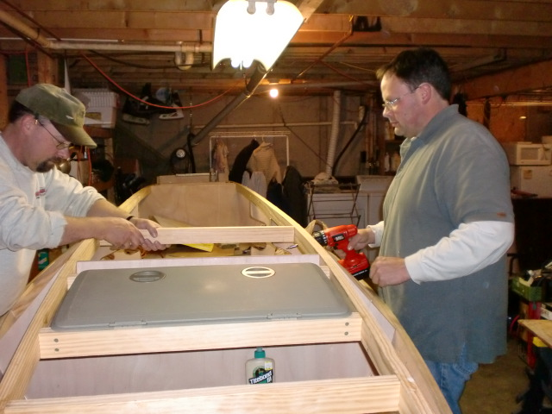
Notes:
Another pound of screws….

Slide 24
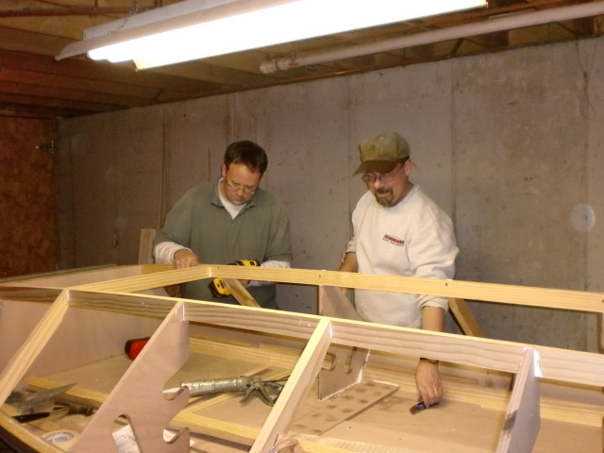
Notes:
“What can I get you?”

Slide 25
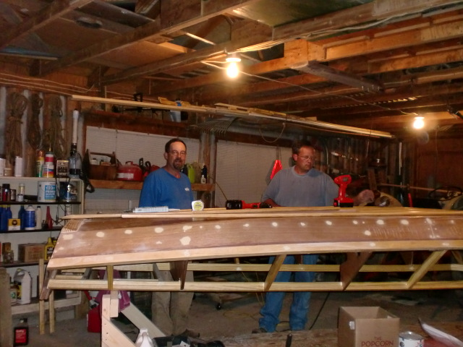
Notes:
It fit through the door! In the garage and working on the bottom and keels.

Slide 26
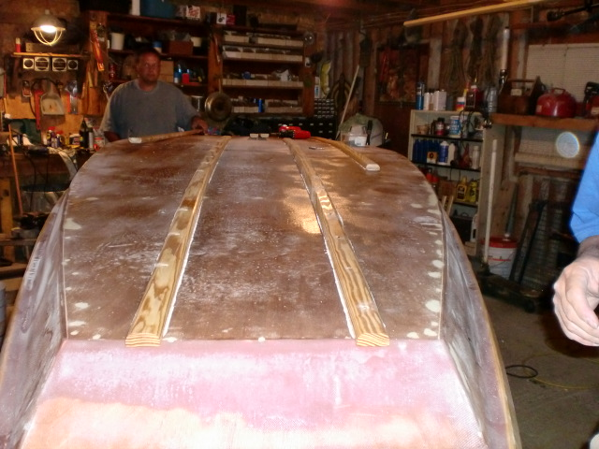
Notes:
Bottom all fiberglassed and keels being installed.

Slide 27
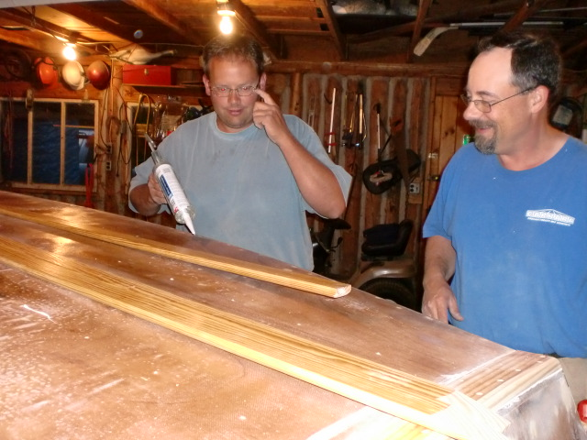
Notes:
Adding outside keels

Slide 28
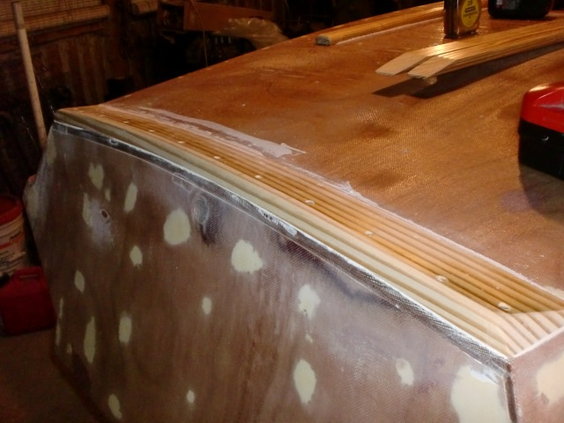
Notes:
High performance professional grade wedge for high speed angle of attack.

Slide 29
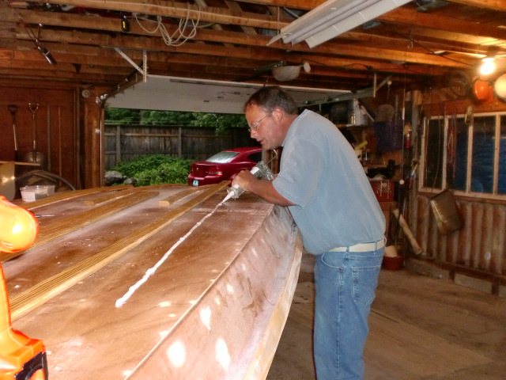
Notes:
Won’t put a caption on this one.

Slide 30
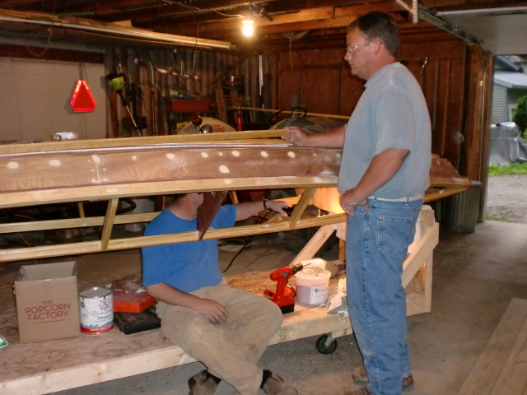
Notes:
Me running the screw gun. What could go wrong?

Slide 31
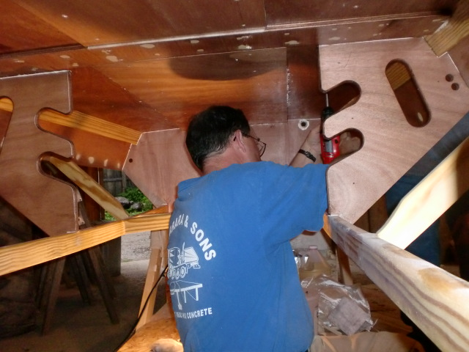
Notes:
Poking more holes in the bottom of the boat.

Slide 32
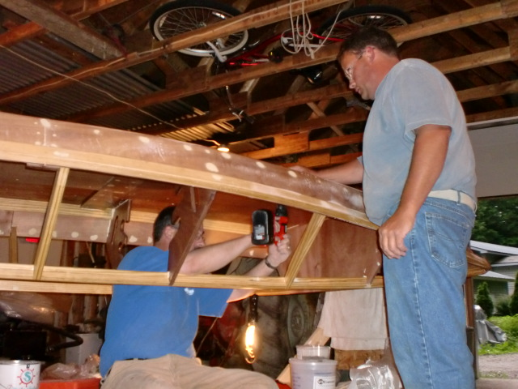
Notes:
And more holes.

Slide 33
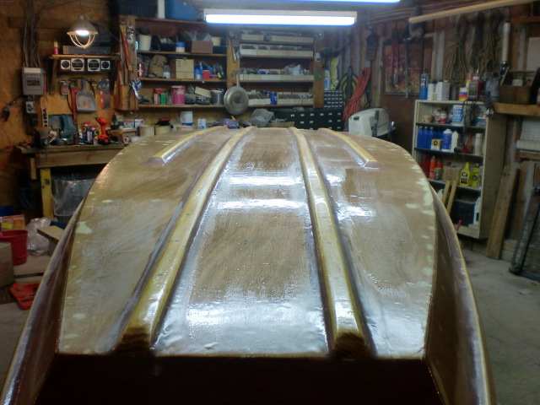
Notes:
Bottom all ready for painting. Keels filleted and epoxied

Slide 34
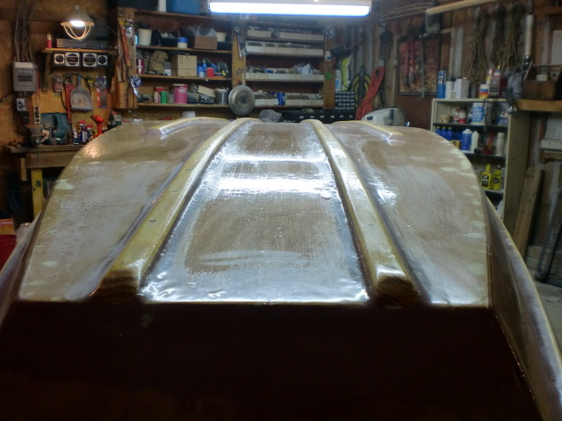
Notes:
Nice and shiny.

Slide 35
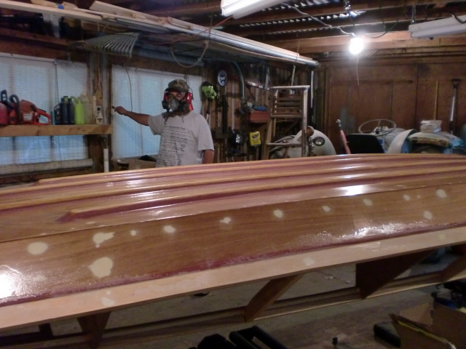
Notes:
Ready for more sanding.

Slide 36
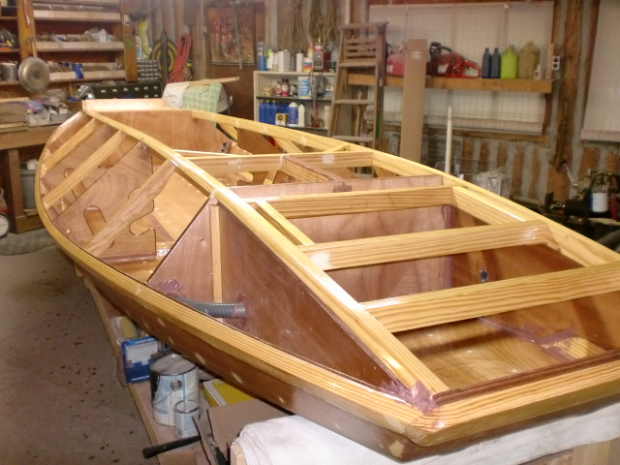
Notes:
Finally flipped over. Front and back compartments ready for foam. Conduits in place for wiring.

Slide 37
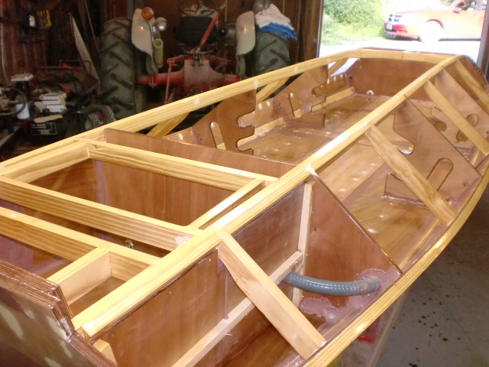
Notes:
Rear compartments and conduit.

Slide 38
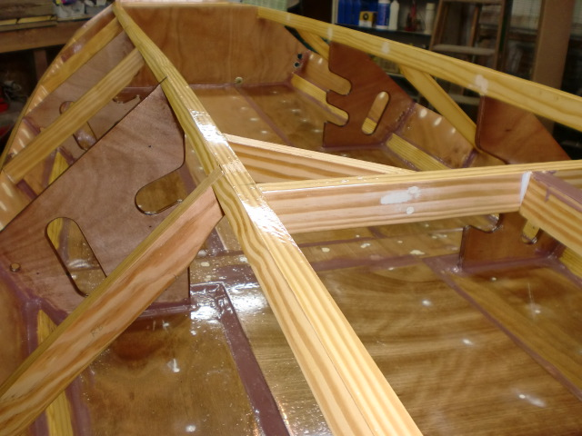
Notes:
Inside ready for final flooring.

Slide 39
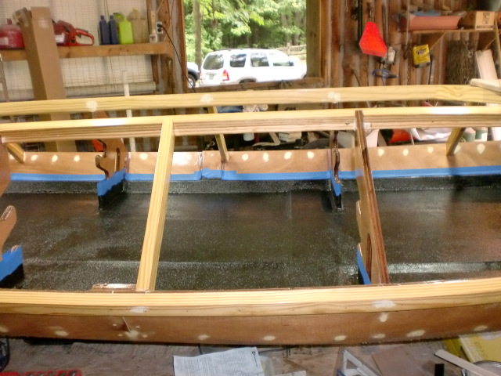
Notes:
Spread on bed liner. This really smelled up the garage!

Slide 40
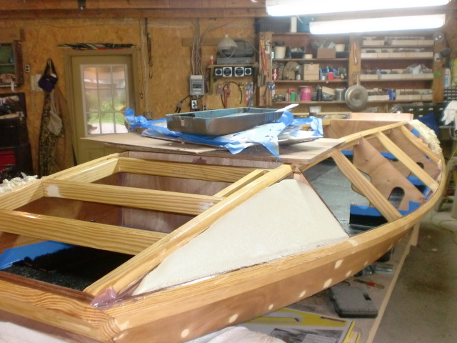
Notes:
Foam added to the floatation compartments.

Slide 41
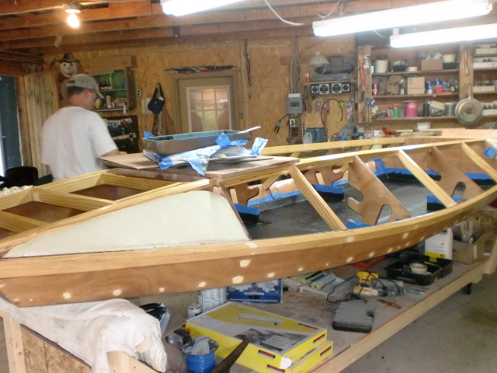
Notes:
Ready for the second coat of bed liner.

Slide 42
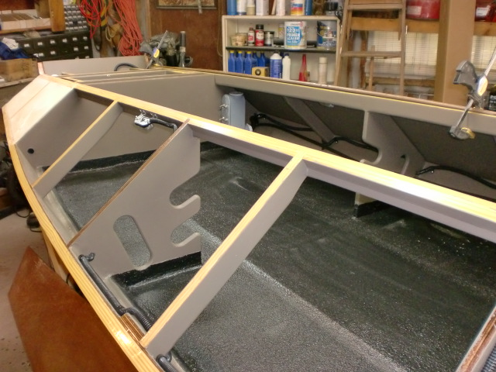
Notes:
Inside all done.

Slide 43
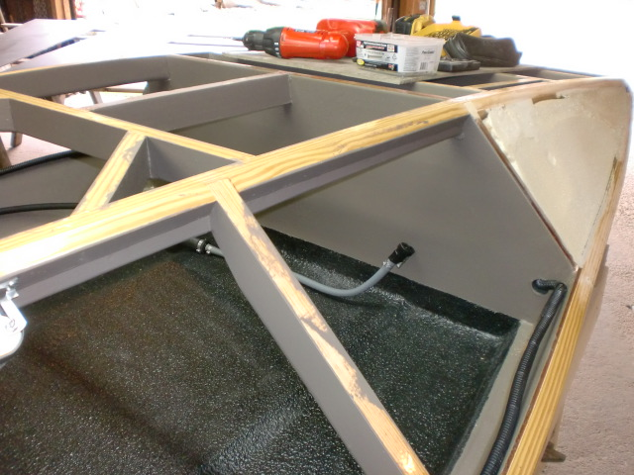
Notes:
Front area for gas tank.

Slide 44
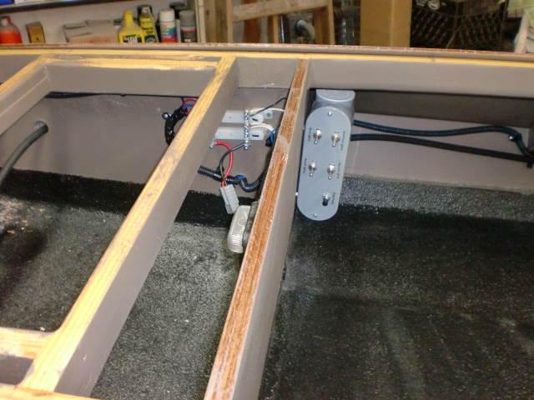
Notes:
Electrical Control Center, Inside lights, hatch lights, head lights, nav lights, and bilge pump.

Slide 45
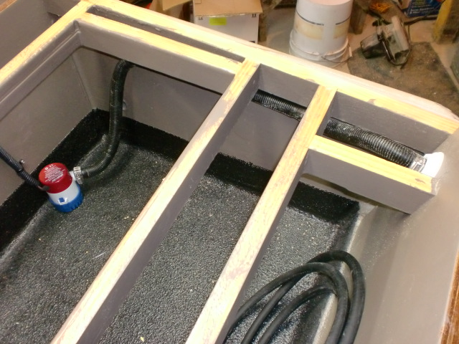
Notes:
Rear compartment for battery and pump/

Slide 46
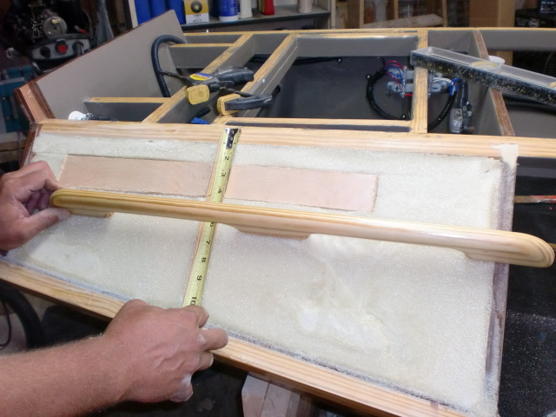
Notes:
Adding backer board for Kyle’s custom handles

