Slide 1
Uncovering the Green Mind
Kathrina Soja

Slide 2
Background
Environmental research primarily focused on physical, versus behavioral or cognitive sciences
Center for Research on Environmental Decisions (CRED)
Current research: How peoples preferences over environmental issues influence their feelings about the environment
Predictive power of base rates of risk, loss, and ambiguity aversion, and time preference
Portfolio choice, occupational choice, smoking, migration, wealth, business ownership, credit card balances, debt, government assistance (Cardenas & Carpenter, 2008; Dohmen et al., 2005; Meier and Spienger, 2007)
Notes:
issuesPeoples perceptions of risks in environmental issues, the effect of ambiguity within the field of climate change, and discount rates for the environment

Slide 3
Methodology
Goal of Research: Measure individual’s time preference, risk preference, ambiguity aversion, and loss aversion and correlate it with their environmental attitudes.
79 Middlebury College Students
Experiments conducted in groups of 4-12 people
Three-part design
Demographic Survey
Four mini experiments designed to measure preferences
20 Question Environmental Attitude Survey
15 Questions from Revised New Environmental Paradigm, 5 additional questions

Slide 4
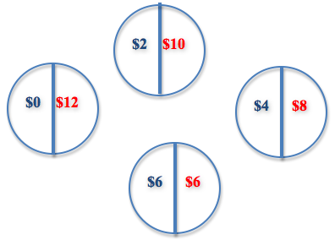
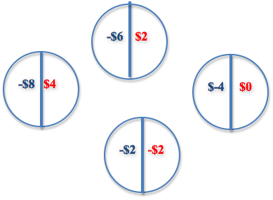
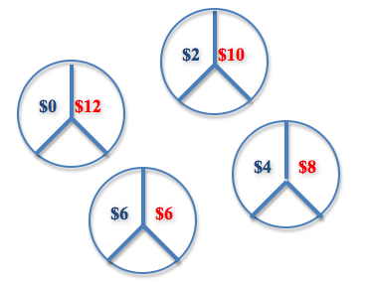
Experimental Design
Risk Aversion
Loss Aversion
Ambiguity Aversion
Time Preference

Slide 5
Table 1: Summary Statistics
 | Mean | St. Dev. | Observations |  |  | Mean | St. Dev. | Observations
Demographics |  |  |  |  | Preferences
Class | 2.30 | 1.11 | 79 |  | Risk Averse | 0.53 | 0.50 | 79
Feb | 0.13 | 0.33 | 79 |  | Loss Averse | 0.49 | 0.50 | 79
Male | 0.63 | 0.49 | 79 |  | Ambiguity Averse | 0.41 | 0.49 | 79
International | 0.11 | 0.32 | 79 |  | Patient | 0.46 | 0.50 | 79
Family Income | 3.64 | 1.82 | 78 |  | Present Bias | 0.22 | 0.41 | 79
White | 0.77 | 0.42 | 79
Democrat | 0.59 | 0.49 | 79 |  | Environmental Survey Questions
Republican | 0.09 | 0.29 | 79 |  | Limits To Growth** | 0.47 | 0.50 | 79
Independent/Other | 0.32 | 0.47 | 79 |  | Antianthropocentrism** | 0.54 | 0.50 | 79
Democrat (Mother) | 0.56 | 0.50 | 79 |  | Fragility of Nature** | 0.59 | 0.49 | 79
Republican (Mother) | 0.23 | 0.42 | 79 |  | Rejection of Exemptionalism** | 0.48 | 0.50 | 79
Idependent/Other (Mother) | 0.22 | 0.41 | 79 |  | Ecocrisis** | 0.54 | 0.50 | 79
Democrat (Father) | 0.48 | 0.50 | 79 |  | Environment over Econ. Growth | 0.58 | 0.50 | 77
Republican (Mother) | 0.32 | 0.47 | 79 |  | Econ. Growth over Environment* | 0.52 | 0.50 | 77
Independent/Other (Father) | 0.20 | 0.40 | 79 |  | Belief in Global Temp. Increase | 0.53 | 0.50 | 77
Economics Classes | 1.48 | 1.92 | 79 |  | Scientist Consensus | 0.64 | 0.48 | 77
Environmental Science Classes | 0.99 | 2.19 | 79 |  | Understanding of Global Warming | 0.44 | 0.50 | 77
Know Experimenter | 0.29 | 0.46 | 79
Know People in Room (#) | 0.81 | 0.85 | 79
* Item was reverse scored
**Aggregate Score

Slide 6
Table 2: Marginal Effects on Facets of an Ecological Worldview
 | Reality of Limits to Growth |  |  | Fragility of Nature's Balance
 | (1) | (2) | (3) | (1) | (2) | (3)
White | -0.13 |  | -0.01 | -0.00 |  | 0.01
 | (0.4) |  | (0.94) | (1.00) |  | (0.96)
International | -0.32** |  | -0.29 | -0.38** |  | -0.45**
 | (0.04) |  | (0.15) | (0.03) |  | (0.02)
Family Income | 0 |  | -0.05 | 0.00 |  | 0
 | (0.96) |  | (0.25) | (0.98) |  | (0.94)
Male | 0 |  | 0.01 | -0.13 |  | -0.17
 | (0.97) |  | (0.95) | (0.27) |  | (0.17)
Northeast | 0.04 |  | 0.17 | 0.06 |  | 0.01
 | (0.74) |  | (0.24) | (0.65) |  | (0.96)
Risk Averse |  | -0.21* | -0.27** |  | 0.14 | 0.18
 |  | (-.08) | (0.04) |  | (0.22) | (0.18)
Loss Averse |  | -0.27** | -0.26* |  | -0.03 | 0.04
 |  | (0.02) | (0.07) |  | (0.79) | (0.75)
Ambiguity Averse |  | -0.19 | -0.23* |  | -0.20* | -0.25*
 |  | (0.13) | (0.07) |  | (0.09) | (0.05)
Patient |  | -0.04 | -0.05 |  | -0.08 | -0.13
 |  | (0.75) | (0.76) |  | (0.55) | (0.38)
Present Bias |  | -0.24 | -0.24 |  | 0.12 | 0.07
 |  | (0.12 | (0.15) |  | (0.44) | (0.71)
Observations | 78 | 79 | 78 | 78 | 79 | 78
P-value in Parentheses
Significance at the 1, 5, and 10 percent levels are denoted respectively by *, **, and ***.

Slide 7
Table 2: Marginal Effects on Total New Environmental Paradigm Score
 |  | NEP Score
 | (1) | (2) | (3)
White | 0.06 |  | 0.12
 | (0.68) |  | (0.48)
International | -0.09 |  | -0.03
 | (0.65) |  | (0.89)
Family Income | -0.01 |  | -0.03
 | (0.88) |  | (0.4)
Male | -0.02 |  | -0.07
 | (0.88) |  | (0.62)
Northeast | 0.05 |  | 0.04
 | (0.69) |  | (0.76)
Risk Averse |  | 0.12 | 0.09
 |  | (0.33) | (0.48)
Loss Averse |  | -0.20* | -0.23*
 |  | (0.09) | (0.08)
Ambiguity Averse |  | -0.23* | -0.23*
 |  | (0.05) | (0.07)
Patient |  | -0.02 | -0.06
 |  | (0.89) | (0.7)
Present Bias |  | 0.22 | 0.18
 |  | (0.15) | (0.28)
Observations | 78 | 79 | 78
P-value in Parentheses
Significance at the 1, 5, and 10 percent levels are denoted respectively by *, **, and ***.

Slide 8
Table 4: Marginal Effects on Environmental Opinions and Attitudes
 | Economic Growth at Environment Expense |  |  | Belief in Global Temp. Increase |  |  | Belief in Scientist Consensus
 | (1) | (2) | (3) | (1) | (2) | (3) | (1) | (2) | (3)
White | 0 |  | -0.03 | 0.16 |  | 0.19 | 0.26* |  | 0.24
 | (0.98) |  | (0.84) | (0.28) |  | (0.24) | (0.09) |  | (0.15)
International | 0.02 |  | 0.25 | -0.27 |  | -0.09 | -0.01 |  | 0.15
 | (0.9) |  | (0.21) | (0.16) |  | (0.72) | (0.98) |  | (0.4)
Family Income | 0.01 |  | 0.03 | 0.01 |  | 0 | -0.02 |  | 0
 | (0.74) |  | (0.38) | (0.83) |  | (0.9) | (0.65) |  | (0.99)
Male | -0.08 |  | -0.16 | -0.12 |  | -0.23* | -0.25** |  | -0.29**
 | (0.52) |  | (0.22) | (0.3) |  | (0.09) | (0.02) |  | (0.01)
Northeast | -0.14 |  | -0.05 | -0.06 |  | 0 | -0.1 |  | -0.03
 | (0.24) |  | (0.7) | (0.65) |  | (0.99) | (0.44) |  | (0.82)
Risk Averse |  | 0.08 | 0.14 |  | 0.05 | 0.09 |  | -0.08 | -0.01
 |  | (0.51) | (0.27) |  | -0.68 | (0.51) |  | (0.48) | (0.91)
Loss Averse |  | -0.16 | -0.25* |  | -0.29** | -0.33** |  | -0.11 | -0.22
 |  | (0.17) | (0.07) |  | (0.01) | (0.01) |  | (0.35) | (0.12)
Ambiguity Averse |  | 0.05 | 0.11 |  | 0.06 | 0.1 |  | 0.16 | 0.22*
 |  | (0.69) | (0.38) |  | (0.65) | (0.44) |  | (0.14) | (0.05)
Patient |  | 0.2 | 0.23 |  | 0.15 | 0.09 |  | 0.28** | 0.22
 |  | (0.13) | (0.11) |  | (0.28) | (0.58) |  | (0.02) | (0.11)
Present Bias |  | -0.01 | -0.09 |  | 0.11 | -0.03 |  | 0.15 | 0.03
 |  | (0.95) | (0.6) |  | (0.48) | (0.88) |  | (0.24) | (0.85)
Observations | 78 | 79 | 78 | 78 | 79 | 78 | 78 | 79 | 78
P-value in parentheses
Significance at the 1, 5, and 10 percent levels are denoted respectively by *, **, and ***.

Slide 9
Conclusion
On NEP questions: Higher significance of experimental variables than demographic variables on environmental attitudes
Scoring methods and sample
Ambiguity and Loss Aversion
Disagreement among external sources decrease the amount of attention paid to them (Cameron, 2005)
Uncertainty over climate change reduces the frequency of green behavior (Swim, 2009)
Policy Implications
Future Research
Larger and more heterogeneous sample
Notes:
onsiderable progress in the economic theory of ambiguity and ambiguity aversion, involving decisions where the decision maker does not know, or is uncertain about, the probabilities attached to various potential outcomes. This is an appropriate characterization of the current understanding of many facets of climate change science: the uncertainty is pervasive and profound, with many unknowns, and “unknown unknowns,” that cannot be characterized in terms of a conventional probability distribution. The conference explores the application of developments in the economic theory of ambiguity to climate change policy, including both mitigation policy (the reduction of greenhouse gas emissions) and adaptation policy (coping with the consequences of climate change)

Slide 10
The End

