Slide 1
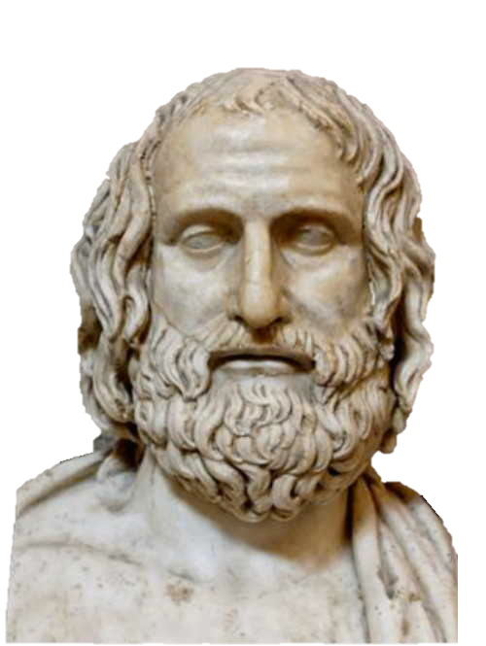
Sextus Empiricus
Kareem Khalifa
Philosophy Department
Middlebury College

Slide 2
Overview
Background
The Five Modes

Slide 3
1. Background
1.1. Belief and appearances
1.2. Standards of skepticism
1.3. Aim of skepticism

Slide 4
2. The Five Modes
2.1. Dispute
2.2. Relativity
2.3. Agrippa’s Trilemma

Slide 5
2.1. Dispute
D1. Equally good arguments for and against p exist.
D2. If equally good arguments for and against p exist, then we should suspend judgment about p.
D3. ∴ We should suspend judgment about p.

Slide 6
2.2. Relativity
2.2.1. ‘Perspectival’ Arguments
2.2.2. ‘Objective’ Arguments

Slide 7
2.2.1. ‘Perspectival’ Arguments
P1. The only way to ascertain which appearances are the objectively correct ones is by appeal to other appearances.
P2. Subjects who differ anatomically, perceptually, environmentally, or culturally will not experience the same appearances.
P3. There are subjects who differ anatomically, perceptually, environmentally, or culturally.
P4. ∴ There is no way to ascertain which appearances are the objectively correct ones.

Slide 8
2.2.2. ‘Objective’ Arguments
P1. The only way to ascertain which appearances are the objectively correct ones is by appeal to other appearances.
O1. Objects appear differently according to their admixtures, composition, quantity, frequency, and position.
O2. ???
P4.∴ There is no way to ascertain which appearances are the objectively correct ones. (S1, O1, O2?)

Slide 9
2.3. Agrippa’s Trilemma
2.3.1. No Free Lunch
2.3.2. The Set-Up
2.3.3. The Argument

Slide 10
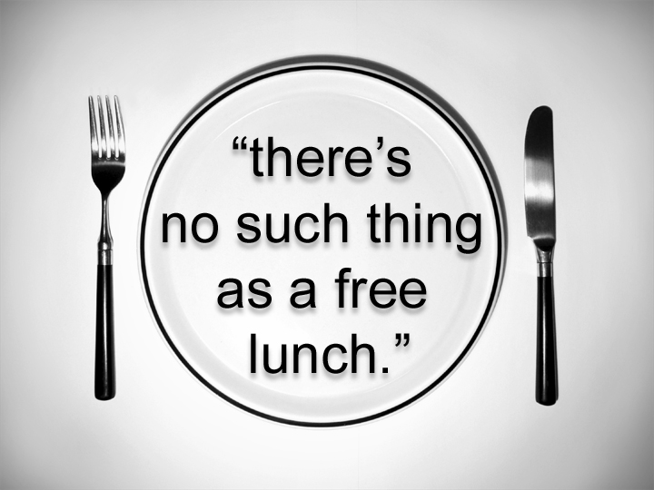
2.3.1.
If q is S’s justification for believing that p, then S must be justified in believing that q.

Slide 11
2.3.2. Setting up the Trilemma
Suppose that you claim to know that p
How do you know that p?
If q is your justification, then you should answer, “Because q”
However, because there are no free lunches, we must be able to answer the question, “How do you that q?”

Slide 12
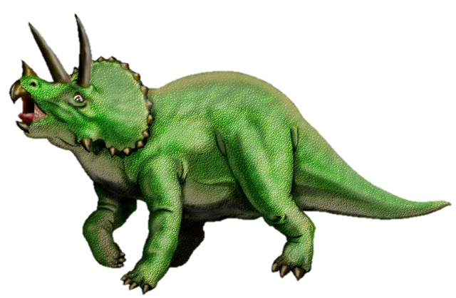
2.3.2. The Three Horns
This line of questioning has only three possible outcomes:
An infinite regress: I know that p because of q, I know that q because of r…
A vicious circle: I know that p because of q, I know that q because of p
An arbitrary stopping point: I know that p because of q, and I know that q just because.
But we don’t possess infinite reasons, and neither viciously circular reasoning nor arbitrary stopping points seem to provide justification.
Hence we aren’t justified in believing in anything!!

Slide 13
2.3.3. The Argument
A1. For all S, p, and q, if q is S’s justification for believing that p, then S must be justified in believing that q.
A2. If A1 is true, then all justification results in an infinite regress, a vicious circle, or stopping at an arbitrary assumption.
A3. We cannot possess an infinite chain of justification.
A4. Viciously circular reasoning does not provide justification.
A5. Stopping at an arbitrary assumption does not provide justification.
A6.∴ No belief is justified. (A1-A5)

