Slide 1
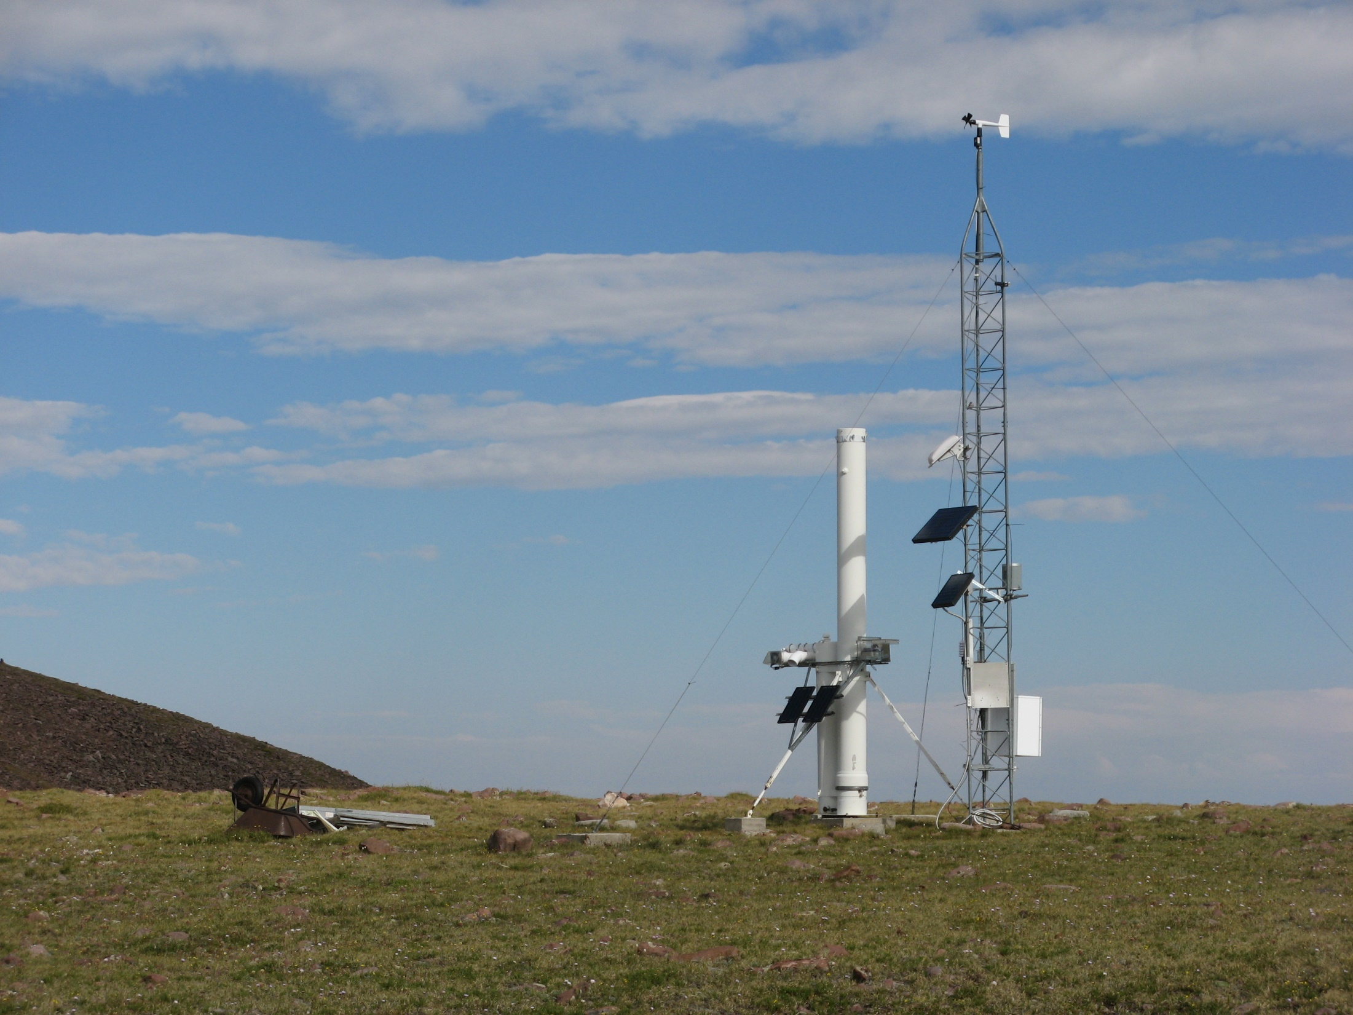
Relative Abundances of Regional vs. Far Traveled Mineral Dust Deposited in the Alpine Zone of the Uinta Mountains, USA
Overview
Study Area
Design
Results
Summary
Jeff Munroe
Middlebury College, USA

Slide 2
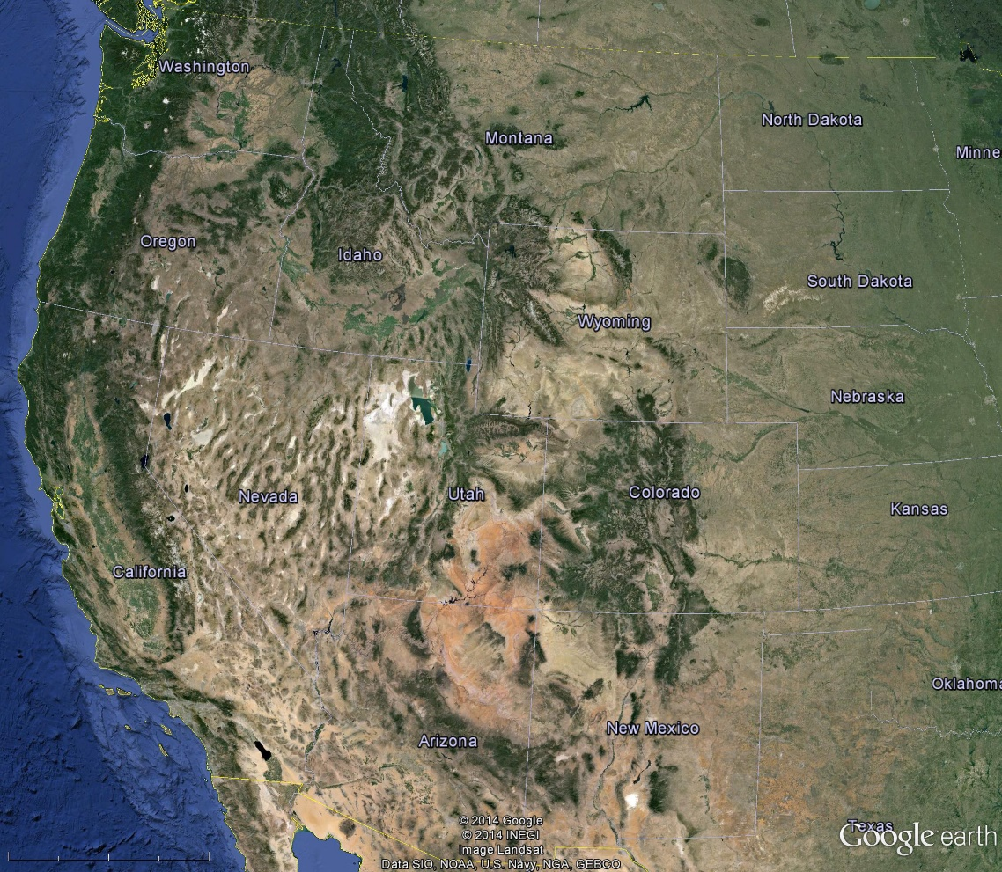
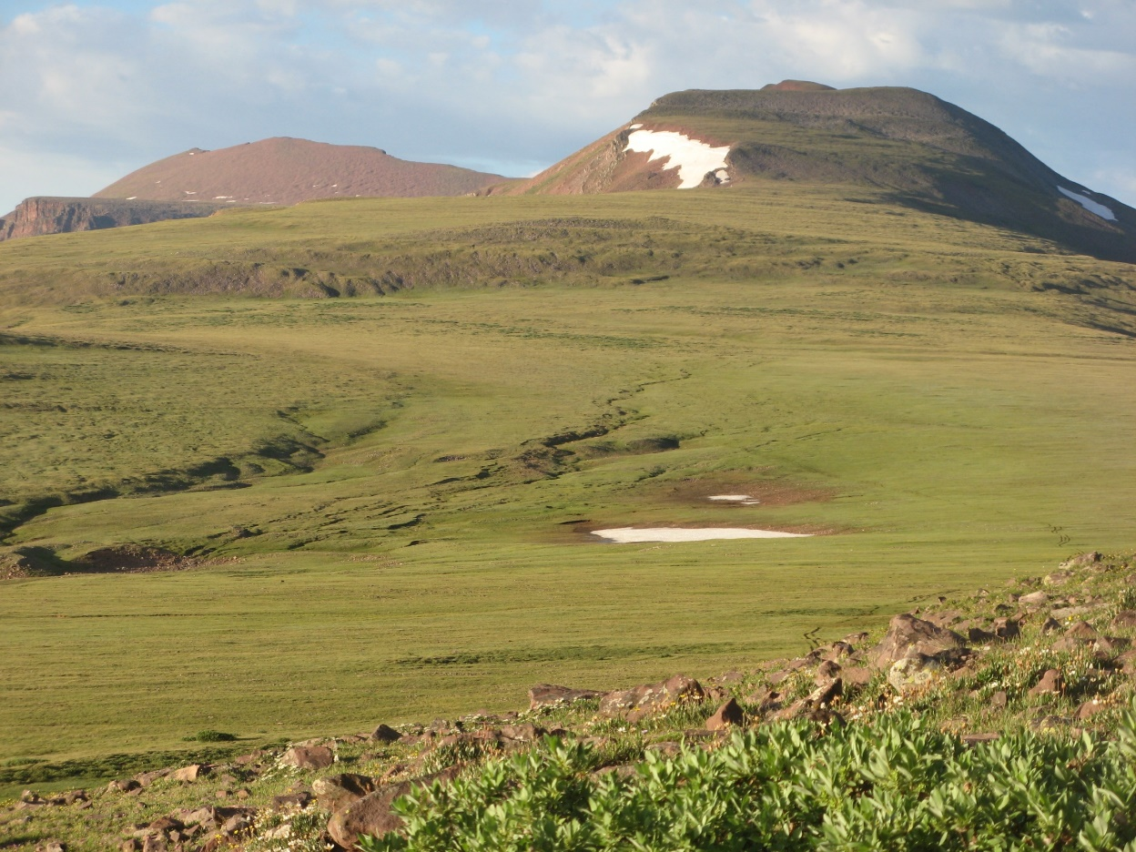
Uinta Mountains
The Uinta Mountains are located in the state of Utah in the western USA. They are surrounded by arid, lowland dust sources.
The highest elevations of the Uinta Mountains are a gently sloping periglacial upland that was not glaciated in the Pleistocene.
Overview
Study Area
Design
Results
Summary

Slide 3
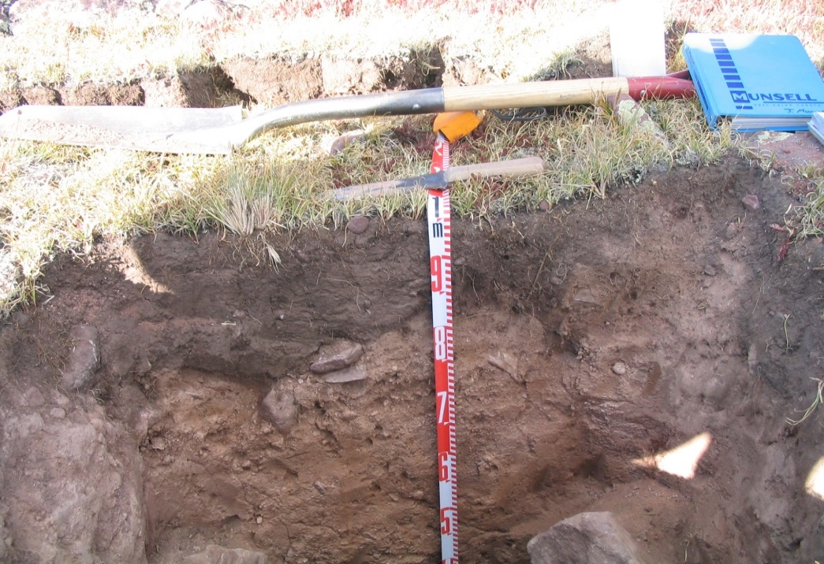
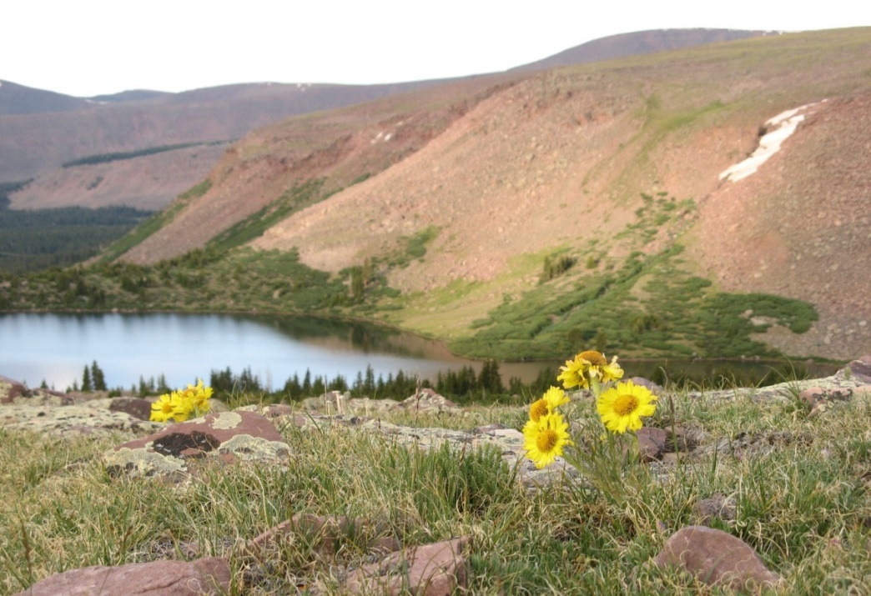
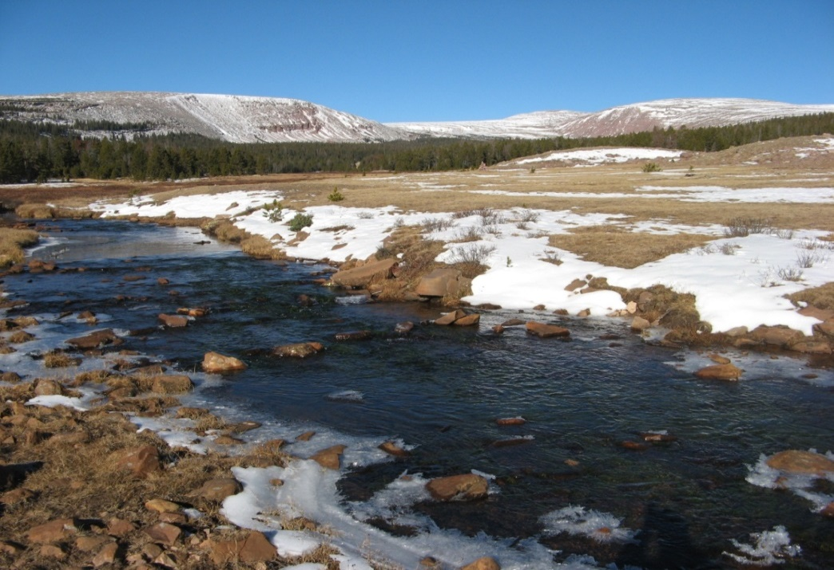
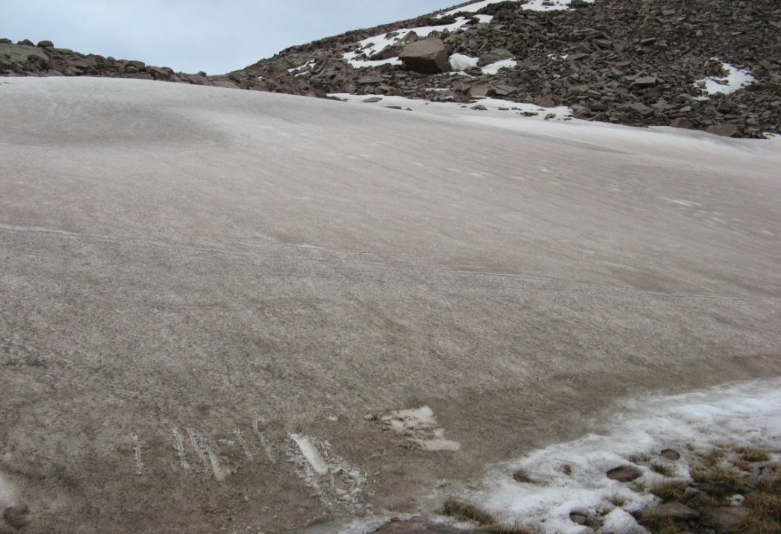
Dust is a Soil Parent Material
Dust is a Source of Base Cations
Dust
Regolith
Why is dust important here?
Dust is a pH Buffer
Dust Impacts Snow Albedo
Overview
Study Area
Design
Results
Summary

Slide 4
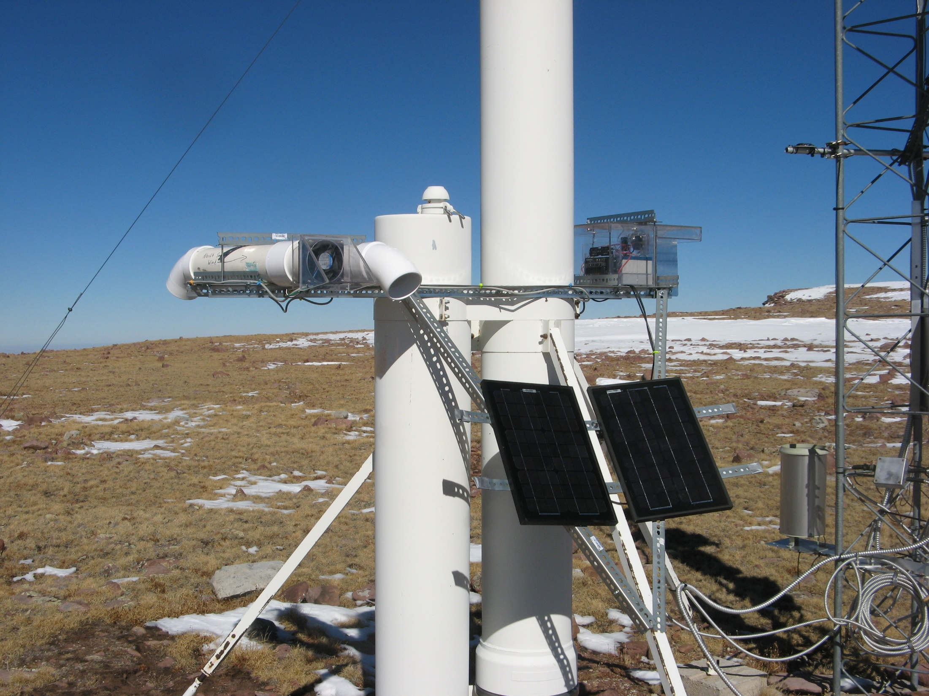
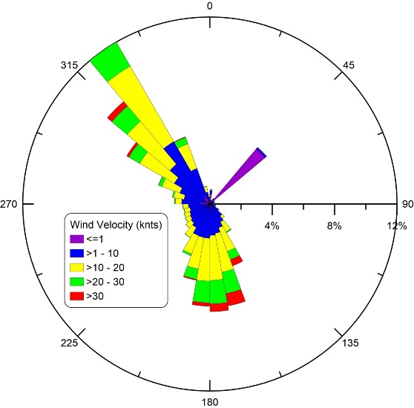
An active sampler was deployed at a location with a strongly bimodal wind regime
S wind
NW wind
Overview
Study Area
Design
Results
Summary

Slide 5
Hypothesis:
If dust is globally sourced, then NW and S samples will be similar.
If local and regional sources of dust are important, then NW and S samples will be different.
Overview
Study Area
Design
Results
Summary

Slide 6
Methods:
Grain Size Analysis
XRD mineralogy
ICP-MS geochemistry
Overview
Study Area
Design
Results
Summary

Slide 7

Uinta Mountains
Possible
dust source
Possible
dust source
Overview
Study Area
Design
Results
Summary

Slide 8
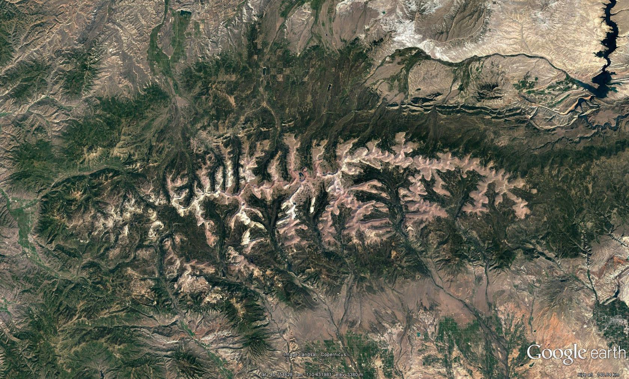
The Uinta Mountains were extensively glaciated during the Pleistocene…
50 km
Overview
Study Area
Design
Results
Summary

Slide 9
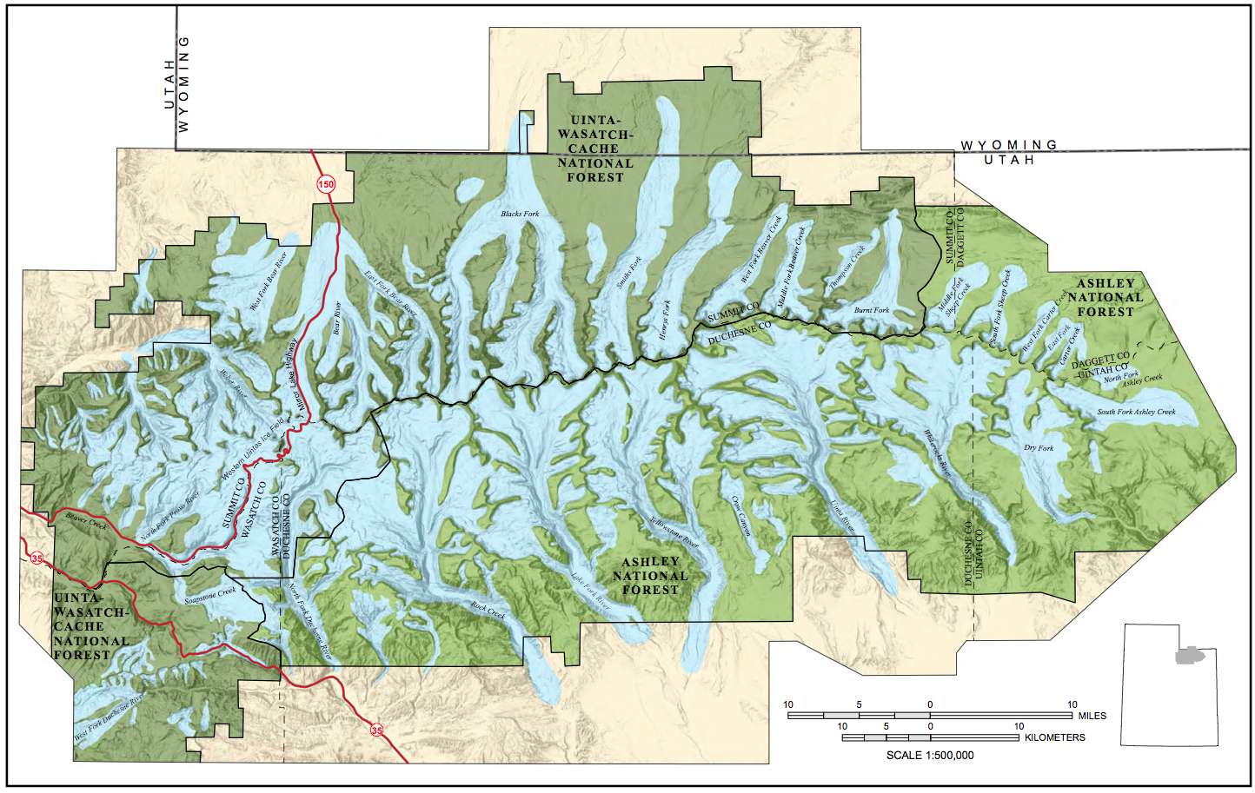
…however the crest of the range was above the limit of Pleistocene glaciers
Reconstructed glaciers
in blue
Munroe and Laabs, 2009
Overview
Study Area
Design
Results
Summary

Slide 10

The ridgecrest is a gently sloping periglacial upland
What is the influence of mineral dust
deposition in this environment?
Overview
Study Area
Design
Results
Summary

Slide 11
Dust is a Soil Parent Material
Dust is a Source of Base Cations
Dust
Regolith
Dust is a pH Buffer
Dust Impacts Snow Albedo
Overview
Study Area
Design
Results
Summary

Slide 12
Research Question:
What is the relative importance of regional versus exotic mineral dust in the Uinta Mountains?
Remote Automated
Weather Station
at 3700 m
Active
Dust
Sampler
Overview
Study Area
Design
Results
Summary

Slide 13
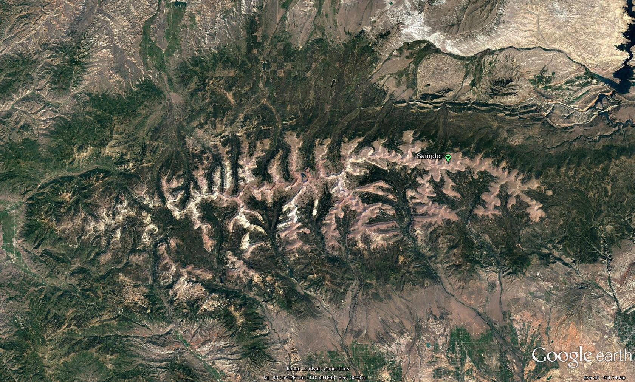
Active Dust Sampler
50 km
Overview
Study Area
Design
Results
Summary

Slide 14

Wind regime
at this site
is strongly bimodal
12-year record
Overview
Study Area
Design
Results
Summary

Slide 15
Hypothesis:
If dust is globally sourced, then NW and S samples will be similar.
If local and regional sources of dust are important, then NW and S samples will be different.
Overview
Study Area
Design
Results
Summary

Slide 16
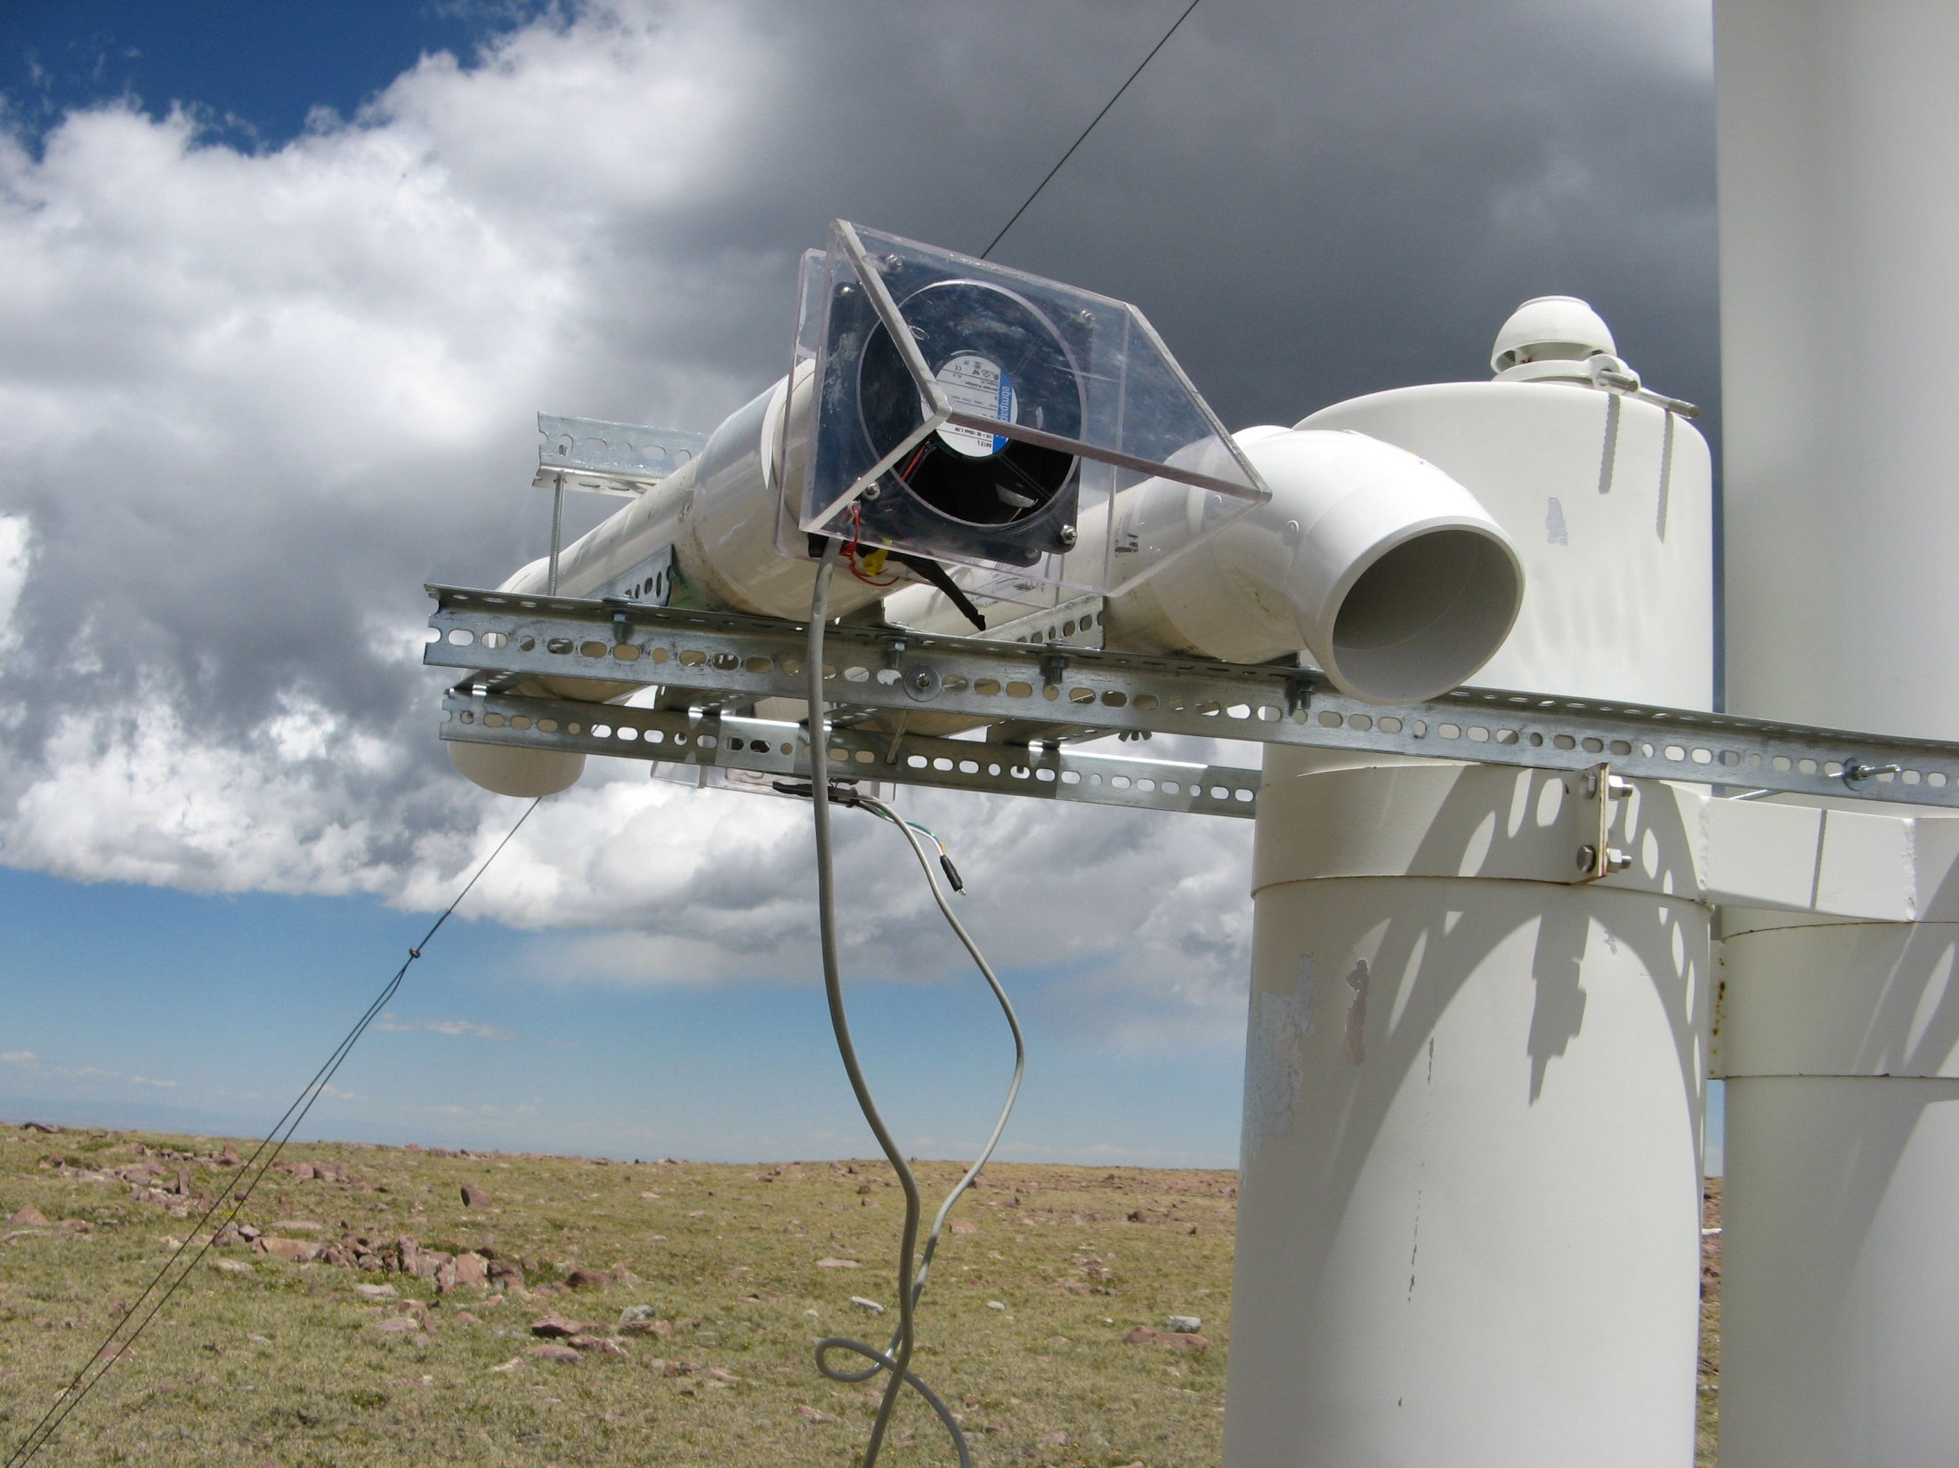
Solar-powered fans pull air through filters to trap dust
One collector is oriented to NW, the other to the S
NW
wind
S
wind
Overview
Study Area
Design
Results
Summary

Slide 17
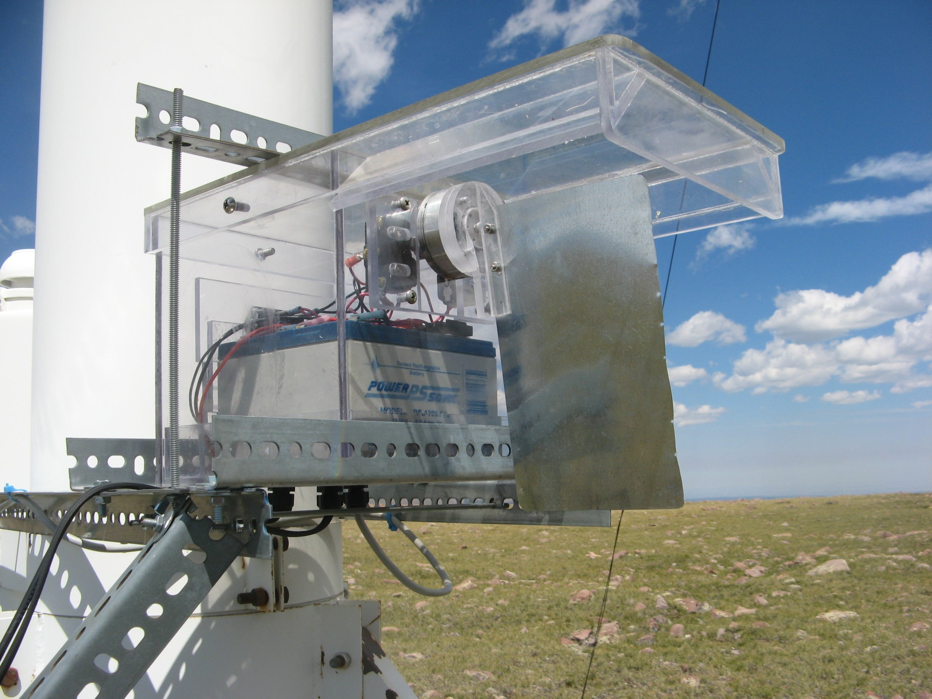
Wind-activated switch turns fans on and off
S
wind
NW
wind
Overview
Study Area
Design
Results
Summary

Slide 18
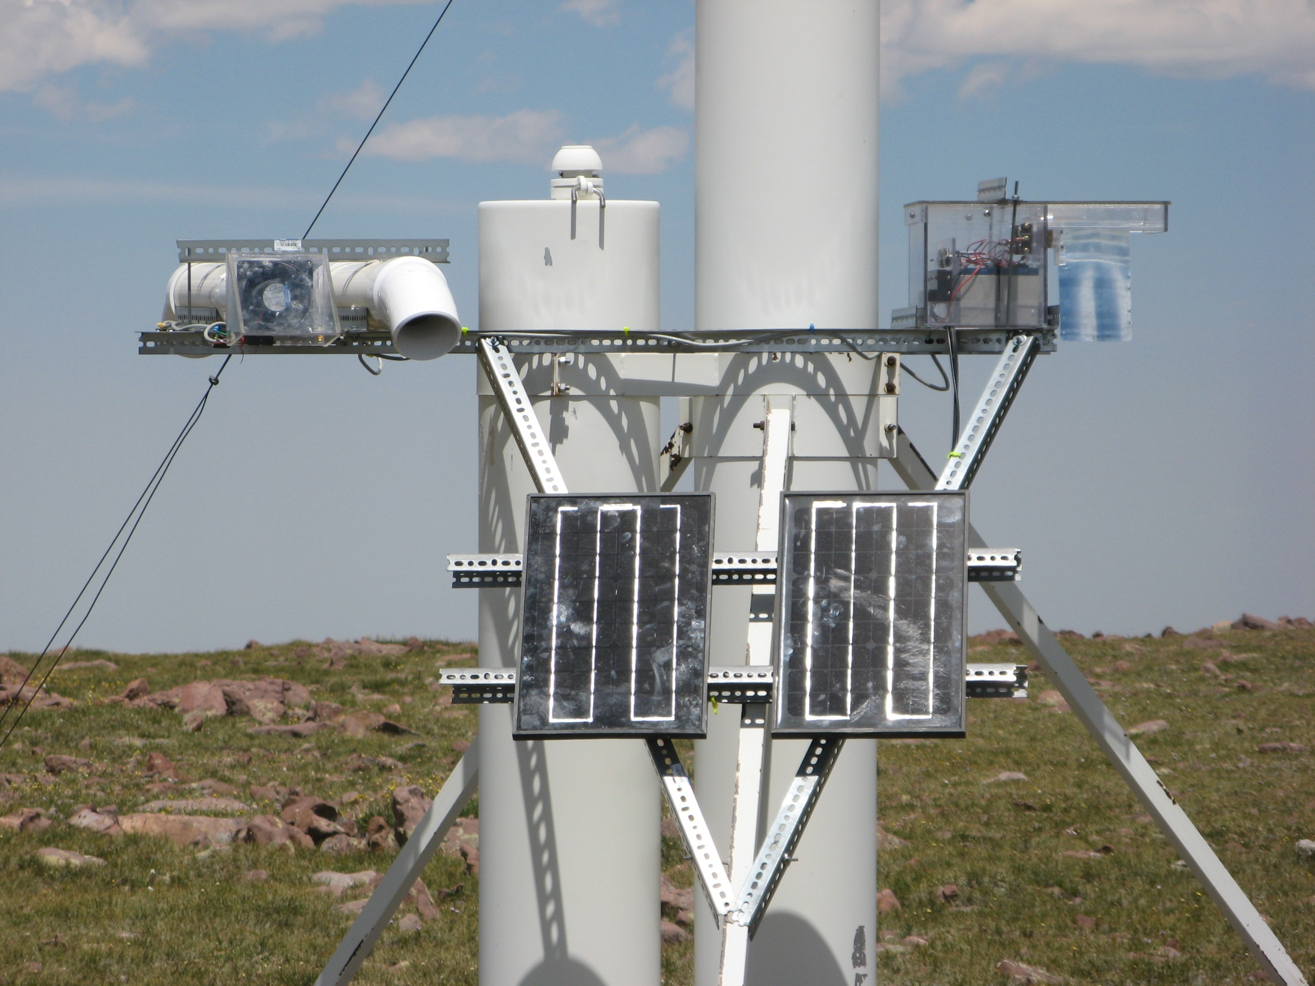
30 Watts of solar power keeps the system running year-round
Overview
Study Area
Design
Results
Summary

Slide 19
Both fans run an average of 2-hr per day
*
*Malfunction during first winter
locked S fan in “on” position
Overview
Study Area
Design
Results
Summary

Slide 20
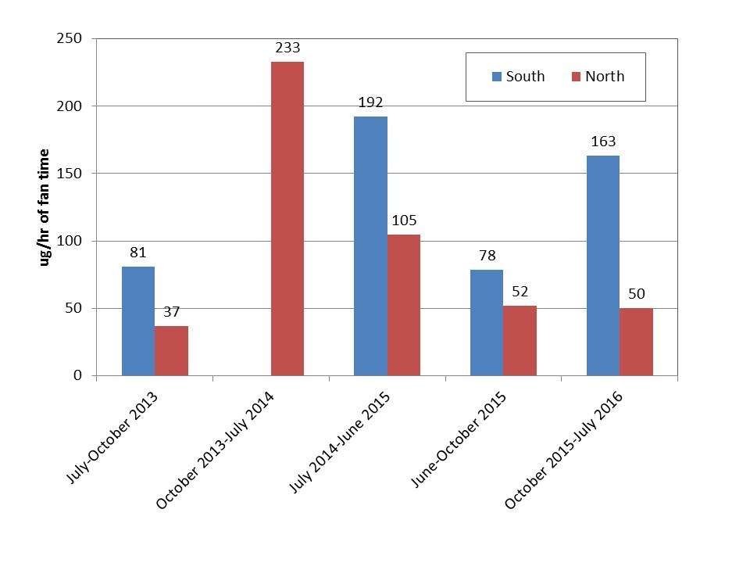
Wind from the S carries more dust than from the NW
Overview
Study Area
Design
Results
Summary

Slide 21
NW dust is coarser
Overview
Study Area
Design
Results
Summary

Slide 22
NW dust has more coarse silt and very fine sand
Overview
Study Area
Design
Results
Summary

Slide 23
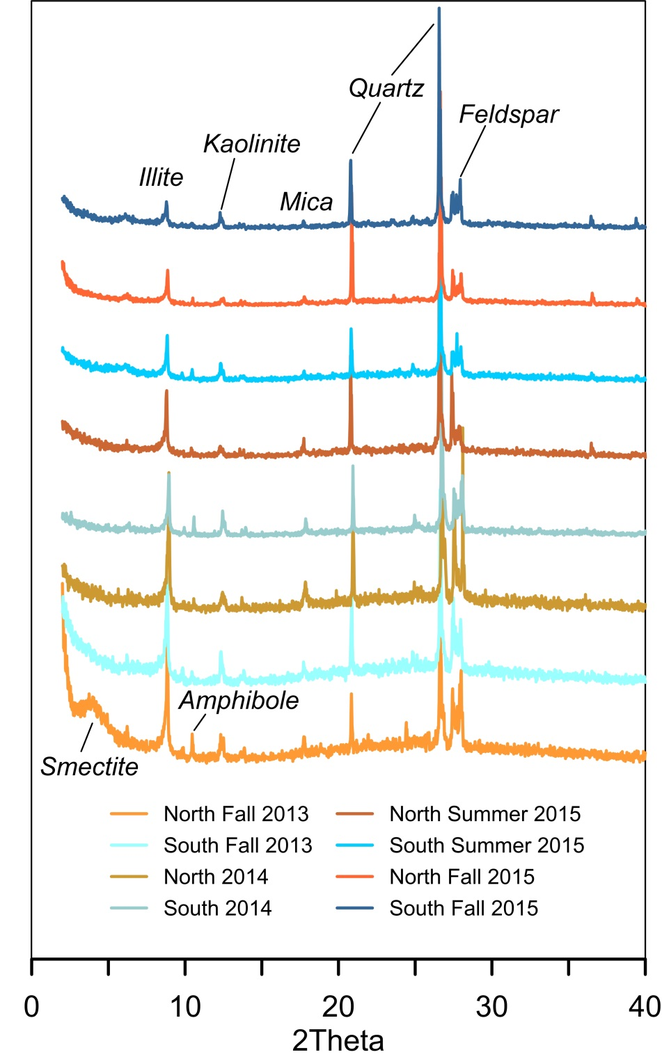
NW and S dust have generally the same minerals detectable with XRD, although some NW samples contain smectite or other expandable clays
Overview
Study Area
Design
Results
Summary

Slide 24
NW dust contains more feldspar
Overview
Study Area
Design
Results
Summary

Slide 25
On a seasonal basis, some elements are more abundant from the S or the NW
Overview
Study Area
Design
Results
Summary

Slide 26
Overview
Study Area
Design
Results
Summary

Slide 27
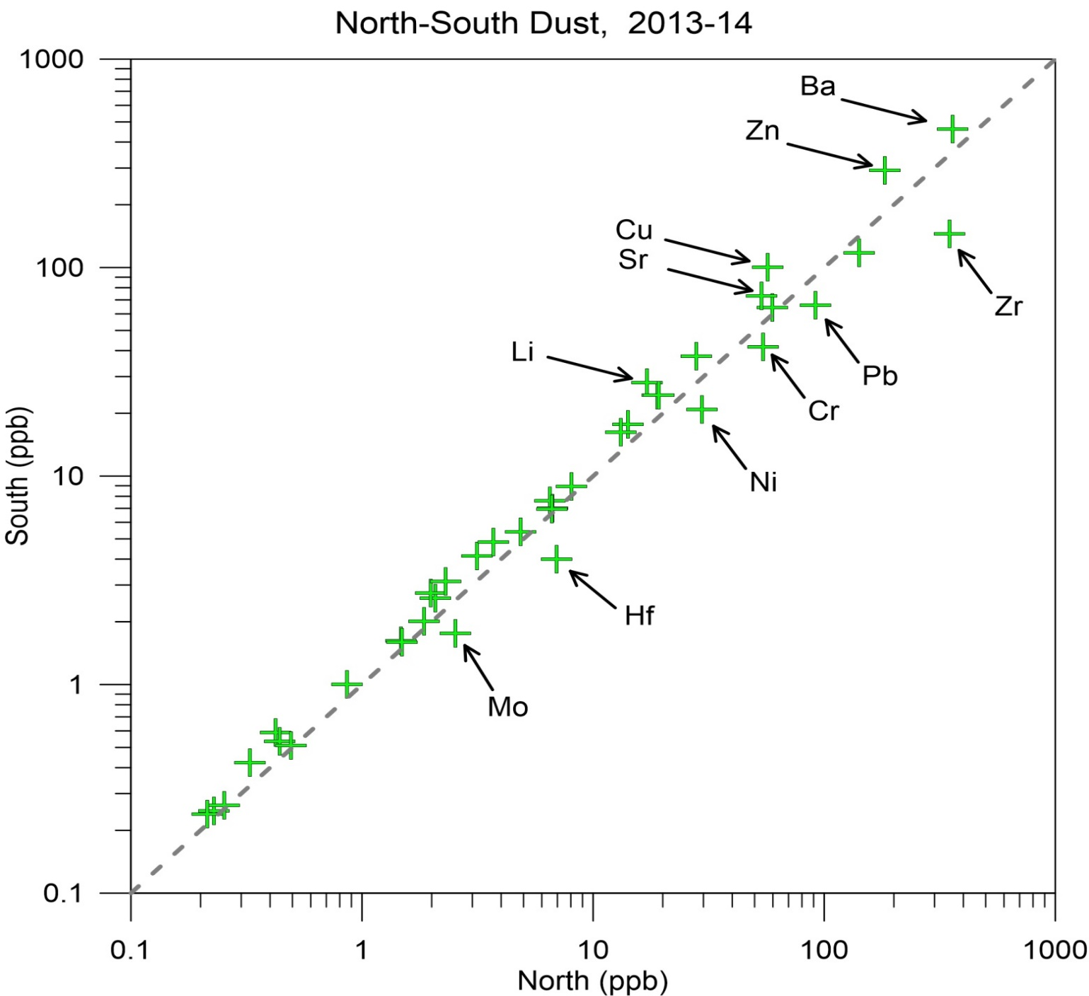
Enrichment of Li and Ba may reflect oil development to the south
Overview
Study Area
Design
Results
Summary

Slide 28
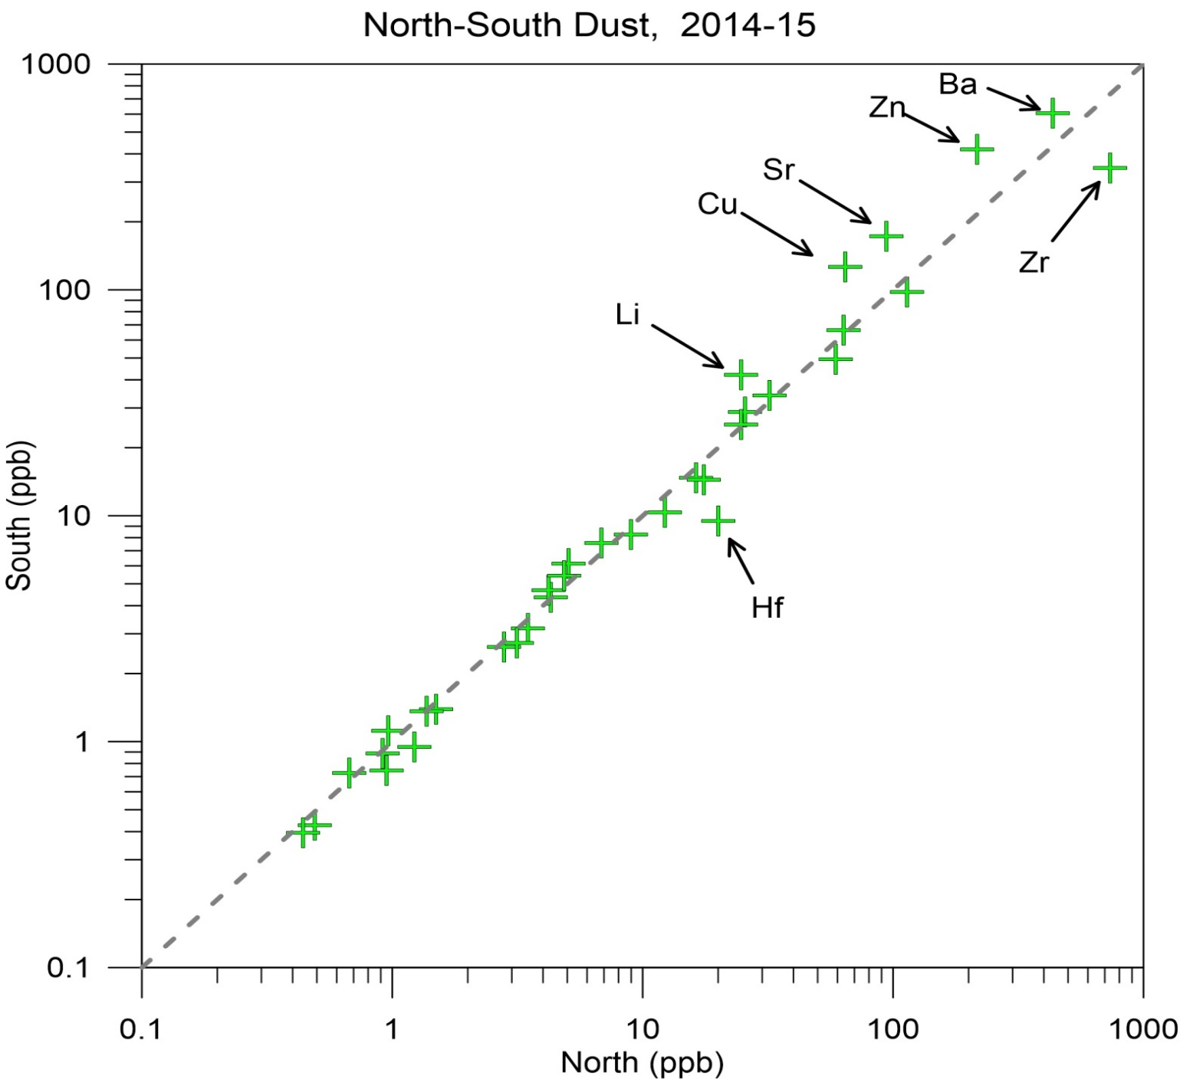
Enrichment of Hf and Zr suggests source of zircon to the north
Overview
Study Area
Design
Results
Summary

Slide 29
Summary:
South wind delivers more dust
S vs. NW mineralogy is similar but NW dust is coarser
Directional element enrichment varies seasonally
Annual enrichments suggest that local sources are an important overprint on uniform, globally sourced dust.
Overview
Study Area
Design
Results
Summary

Slide 30
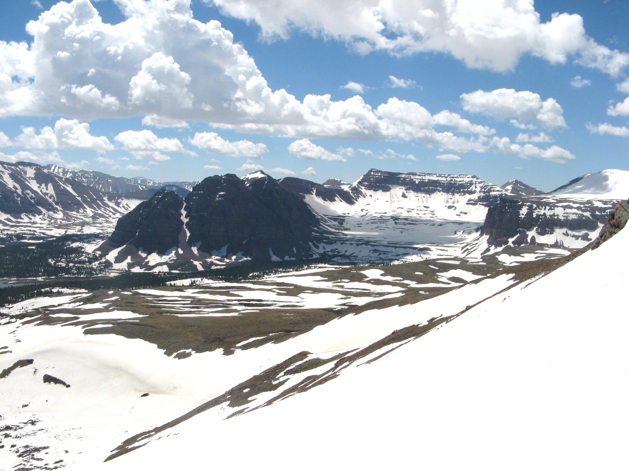
Thanks to…
Emily Attwood, Sam O’Keefe, and Paul Quackenbush
Tony Desautels and Chris Goodrich
NSF-EAR-1524476
USFS-Ashley National Forest
Middlebury College

